Slide 1
Chapter 5
SQL: Advanced Queries and Views

Slide 2
Chapter 5 Outline
More Complex SQL Retrieval Queries
Views (Virtual Tables) in SQL
Schema Change Statements in SQL

Slide 3
More Complex SQL Retrieval Queries
Additional features allow users to specify more complex retrievals from database:
  Nested queries, joined tables, outer joins, aggregate functions, and grouping

Slide 4
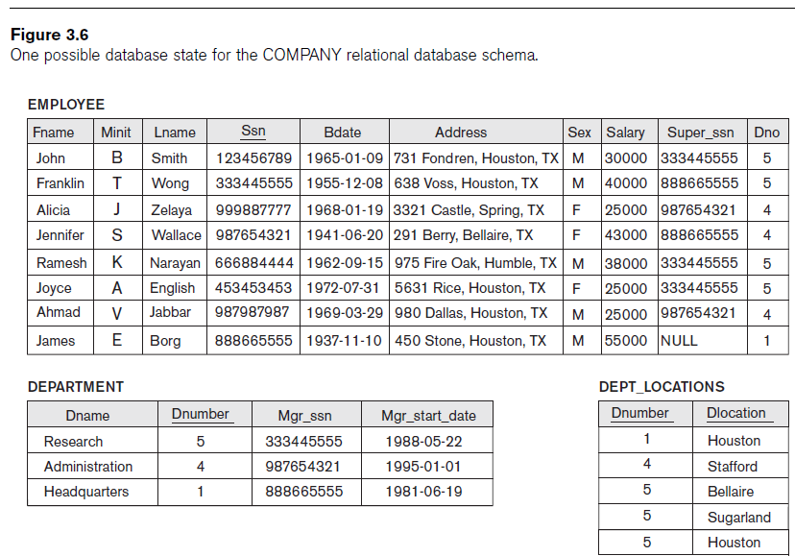

Slide 5
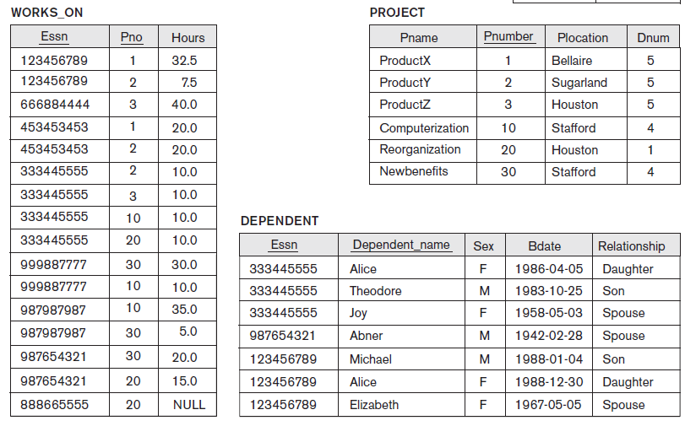

Slide 6
Comparisons Involving NULL and Three-Valued Logic
Meanings of NULL
  Unknown value
  Unavailable or withheld value
  Not applicable attribute
Each individual NULL value considered to be different from every other NULL value
SQL uses a three-valued logic:
  TRUE, FALSE, and UNKNOWN

Slide 7
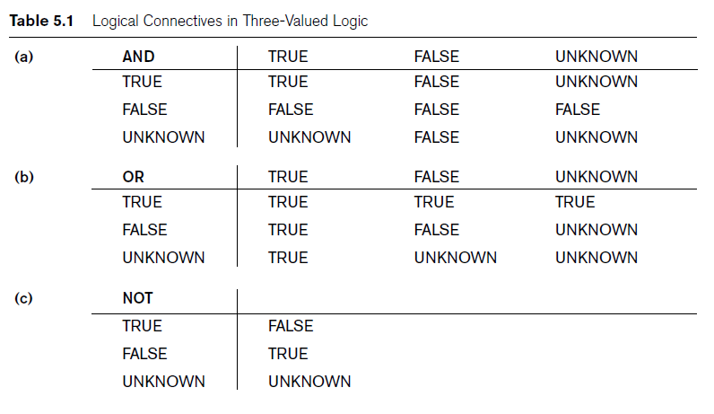
Comparisons Involving NULL and Three-Valued Logic (cont’d.)

Slide 8

Comparisons Involving NULL and Three-Valued Logic (cont’d.)
SQL allows queries that check whether an attribute value is NULL
  IS or IS NOT NULL

Slide 9
Nested Queries, Tuples, and Set/Multiset Comparisons
Nested queries
  Complete select-from-where blocks within WHERE clause of another query
  Outer query
Comparison operator IN
  Compares value v with a set (or multiset) of values V
  Evaluates to TRUE if v is one of the elements in V

Slide 10
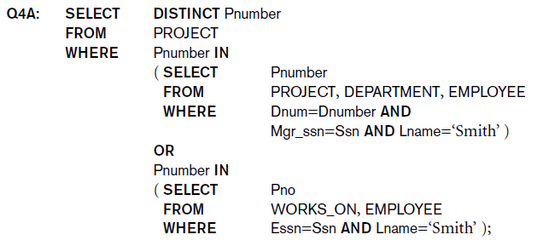
Nested Queries (cont’d.)
Q4:List all project numbers for projects that involve an employee whose last name is Smith either as a worker or as a manager of the department that controls the project

Slide 11
Unions, intersect, except
Rewrite Q4 using union

Slide 12
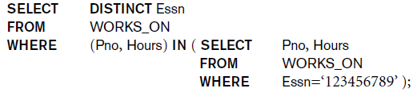
Nested Queries (cont’d.)
Use tuples of values in comparisons
  Place them within parentheses

Slide 13
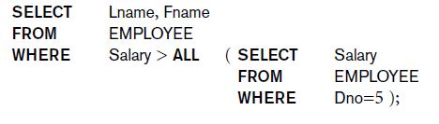
Nested Queries (cont’d.)
Use other comparison operators to compare a single value v
  = ANY (or = SOME) operator
    Returns TRUE if the value v is equal to some value in the set V and is hence equivalent to IN
  Other operators that can be combined with ANY (or SOME): >, >=, <, <=, and <>

Slide 14
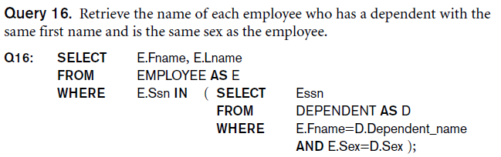
Nested Queries (cont’d.)
Avoid potential errors and ambiguities
  Create tuple variables (aliases) for all tables referenced in SQL query

Slide 15

Joined Tables in SQL and Outer Joins
Joined table
  Permits users to specify a table resulting from a join operation in the FROM clause of a query
The FROM clause in Q1A
  Contains a single joined table
Retrieve the name and address of all employees who work for the ‘Research’ department

Slide 16
Aggregate Functions in SQL
Used to summarize information from multiple tuples into a single-tuple summary
Grouping
  Create subgroups of tuples before summarizing
Built-in aggregate functions
  COUNT, SUM, MAX, MIN, and AVG
Functions can be used in the SELECT clause or in a HAVING clause

Slide 17
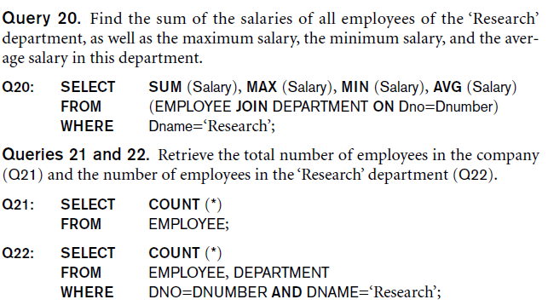
Aggregate Functions in SQL (cont’d.)
NULL values discarded when aggregate functions are applied to a particular column

Slide 18
Grouping: The GROUP BY and HAVING Clauses
Partition relation into subsets of tuples
  Based on grouping attribute(s)
  Apply function to each such group independently
GROUP BY clause
  Specifies grouping attributes

Slide 19
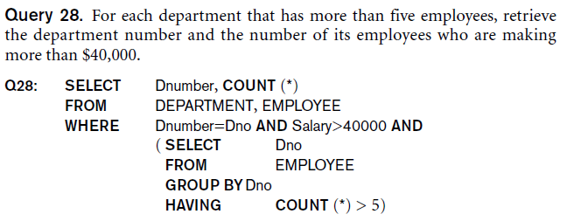
Grouping: The GROUP BY and HAVING Clauses (cont’d.)
HAVING clause
  Provides a condition on the summary information

Slide 20
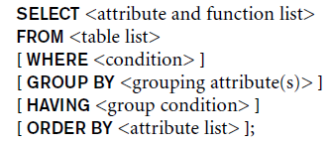
Discussion and Summary of SQL Queries

Slide 21
Views (Virtual Tables) in SQL
Concept of a view in SQL
  Single table derived from other tables
  Considered to be a virtual table

Slide 22
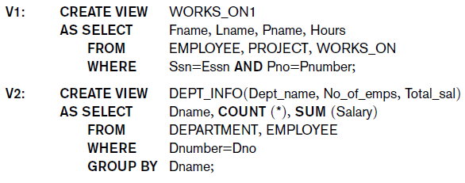
Specification of Views in SQL
CREATE VIEW command
  Give table name, list of attribute names, and a query to specify the contents of the view

Slide 24
Specification of Views in SQL (cont’d.)
Specify SQL queries on a view
View always up-to-date
  Responsibility of the DBMS and not the user
DROP VIEW command
  Dispose of a view

Slide 25
The DROP Command
DROP command
  Used to drop named schema elements, such as tables, domains, or constraint
Drop behavior options:
  CASCADE and RESTRICT
Example:
  DROP SCHEMA COMPANY CASCADE;

Slide 26
The ALTER Command
Alter table actions include:
  Adding or dropping a column (attribute)
  Changing a column definition
  Adding or dropping table constraints
Example:
  ALTER TABLE COMPANY.EMPLOYEE ADD COLUMN Job VARCHAR(12);
To drop a column
  Choose either CASCADE or RESTRICT

Slide 27
Summary
Complex SQL:
  Nested queries, joined tables, outer joins, aggregate functions, grouping
Views
  Virtual or derived tables

